Slide 1
INTRODUCTION TO ECONOMICS
. HAROON RASHID
Assistant Professor Economics
Govt. Post Graduate College Rajouri.
Why Study Economics?
1. The first reason to study Economics is that it will help you understand the World in which you live. You will begin to understand the causes of many of the things that affect your life.
2. The Second reason to study Economics is that it will make you a more astute participant in the Economy.
3. The third reason to study Economics is that it will gave you a better understanding of both potential and the limits of economic policy.

Slide 2
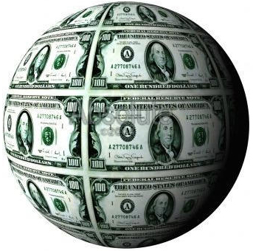

The Study of Economics
Economics – the study of how individuals and societies make decisions about ways to use scarce resources to fulfill wants and needs.
Macroeconomics
  The big picture: growth, employment, Inflation poverty etc.
  Choices made by large groups (like countries)
Microeconomics
  How do individuals make economic decisions.

Slide 3
Positive and Normative Economics
Health care can be improved with more tax funding
Pollution control is effective through a system of fines
Society ought to provide homes for all
Any strategy aimed at reducing factory closures in deprived areas would be helpful
Positive Statements:
  Capable of being verified or refuted by resorting to fact or further investigation
Normative Statements:
  Contains a value judgement which cannot be verified by resort to investigation or research

Slide 4
The Basic Principles of Economics
The Eight Basic Principles of Economics
  Basic Principle 1: Maximization Subject to Constraints
  Basic Principle 2: Opportunity Cost
  Basic Principle 3: Specialization and Exchange
  Basic Principle 4: Markets and Equilibrium
  Basic Principle 5: Policy Tradeoffs
  Basic Principle 6: Marginal Decision Making
  Basic Principle 7: Short-Run versus Long-Run Outcomes
  Basic Principle 8: The Importance of Real Values

Slide 5
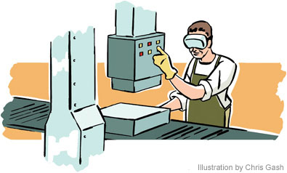
ECONOMICS: 5 Economic
Questions
Society (we) must figure out
WHAT to produce (make)
HOW MUCH to produce (quantity)
HOW to Produce it (manufacture)
FOR WHOM to Produce (who gets what)
WHO gets to make these decisions?

Slide 6
Scarcity and Social Choice
The problem for society is a scarcity of resources
  Scarcity of Labor
    Time human beings spend producing goods and services
  Scarcity of Capital
    Something produced that is long-lasting, and used to make other things that we value
      Human capital
      Capital stock
  Scarcity of land
    Physical space on which production occurs, and the natural resources that come with it
  Scarcity of entrepreneurship
    Ability and willingness to combine the other resources into a productive enterprise
As a society our resources—land, labor, and capital—are insufficient to produce all the goods and services we might desire
  In other words, society faces a scarcity of resources

Slide 7
Scarcity and Economics
The scarcity of resources—and the choices it forces us to make—is the source of all of the problems studied in economics
  Households allocate limited income among goods and services
  Business firms choices of what to produce and how much are limited by costs of production
  Government agencies work with limited budgets and must carefully choose which goals to pursue
Economists study these decisions to
  Explain how our economic system works
  Forecast the future of our economy
  Suggest ways to make that future even better

Slide 8
Production Possibility Frontiers
Show the different combinations of goods and services that can be produced with a given amount of resources
No ‘ideal’ point on the curve
Any point inside the curve – suggests resources are not being utilised efficiently
Any point outside the curve – not attainable with the current level of resources
Useful to demonstrate economic growth and opportunity cost.

Slide 9
Production Possibility Frontiers
It can only produce at points outside the PPF if it finds a way of expanding its resources or improves the productivity of those resources it already has. This will push the PPF further outwards.
Production inside the PPF – e.g. point B means the country is not using all its resources
Capital Goods
C
Y1
Yo
.B
A
Xo
X1
Consumer Goods

Slide 10
The Factors of Production
The production of all of the good we desire requires scarce resources. It is the allocation of these resources between humans’ competing wants that Economics focuses on.
Land | Labor | Capital | Entrepreneurship
Land resources are those things that are "gifts of nature". The soil in which we grow food, wood, minerals such as copper and tin and resources such as oil, goal, gas and uranium are scarce | Labor refers to the human resources used in the production of goods and services. Labor is the human work, both physical and intellectual, that contributes to the production of goods and services | Capital refers to the tools and technologies that are used to produce the goods and services we desire. Since more and better tools enhance the production of all types of goods and services, from cars to computers to education to haircuts, yet the amount of capital in the world is limited, capital is a scarce resource. | This refers to the innovation and creativity applied in the production of goods and services. The physical scarcity of land, labor and capital does not apply to human ingenuity, which itself is a resource that goes into the production of out economic output.

Slide 11
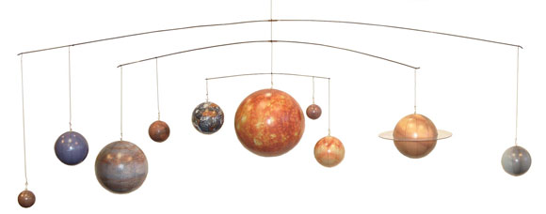
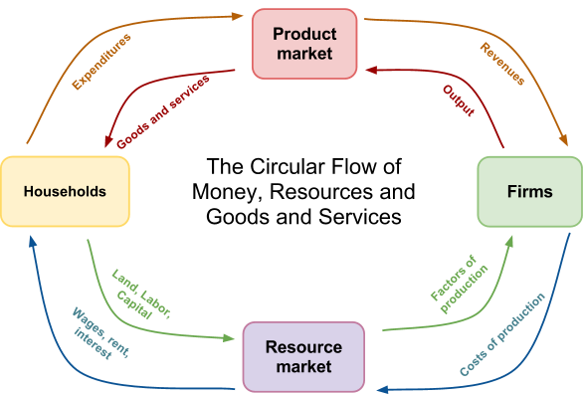
Model Building in Economics
A popular tool in the Economist’s kit is the economic model. Just like scientists in other fields, economists use models to represent something from the real world.
A model of the solar system: Allows astronomers to illustrate in a simplified model the relationships between solar bodies.
A Circular Flow Model: Allows economists to illustrate in a simplified model the relationships between households and firms in a market economy.
Ceteris Paribus: Like in other scientists, when using economic models we must assume “all else equal”. This allows us to observe how one variable in an economy will affect another, without considering all the other factors that may affect the variable in question.

Slide 12
How to Study Economics
Following alone in class and learning are two different things
  Economics must be studied actively, not passively
What does active studying mean?
  Closing the book periodically and reproducing what you have learned
  Reading with a pencil in your hand and a blank sheet of paper in front of you
  Listing the steps in each logical argument
  Retracing the cause-and-effect steps in each model
  Drawing the graphs that represent the model
  Thinking about the basic principles of economics and how they relate to what you are learning.

Slide 13
THANK YOU

